Slide 1
S13T6
Grace, Jason, Madeleine, Patrick, Nikhil
Fall Project
Notes:
Fill this slide in with the relevant team and project information

Slide 2
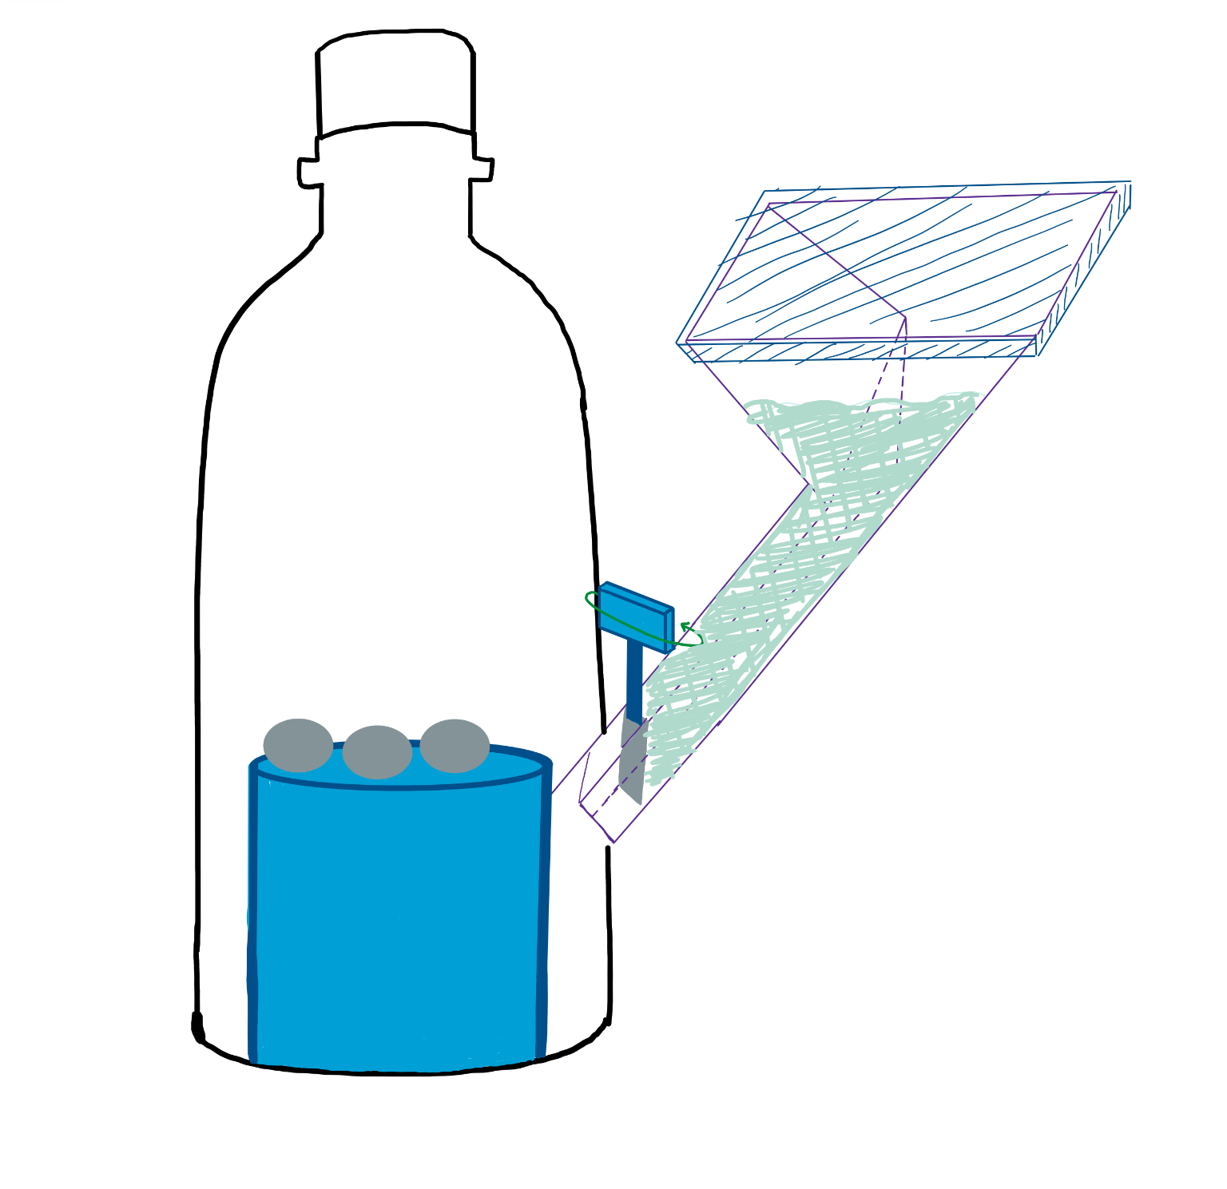
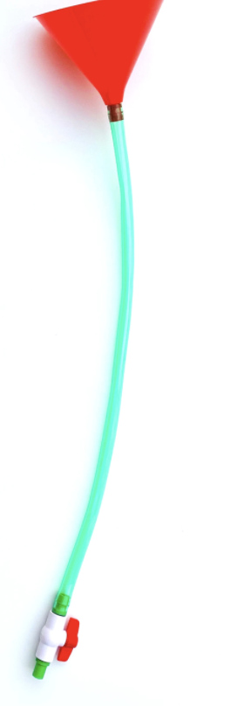
Overall Device Design
- Rubric: The device is described fully and clearly as a system along with how it would operate.
Pressure gauge/ bottle cap
Soda water
- The solvent outside of the reaction chamber
- The cap for the chamber, which has the gauge attached that measures our pressure outcome
lid
- Closes the funnel to stop the pressure from leaking out
Pop bottle
- The chamber that holds the reaction into a set volume
Funnel
Mentos
- Holds the soda water outside of the reaction chamber while being connected to it
- The Solute already in the reaction chamber
valve
stand
- Elevates the mentos to allow the soda water to fully enter the pop bottle before the reaction takes place
- The stop valve that separates the soda water from the reaction chamber

Slide 3
Device Pre-Operation (Setup) Configuration
Replace with a
Stage 1: Mentos are dropped onto the stand from the cap of the vessel. The vessels cap is resealed.
Stage 2: Funnel and tube is filled with soda water while the valve is still closed. The lid on the funnel will be closed and sealed once the appropriate amount of soda water has been poured in.
Stage 3: Vessel is ready to be used, twisting the valve open commences the reaction.
-

Slide 4
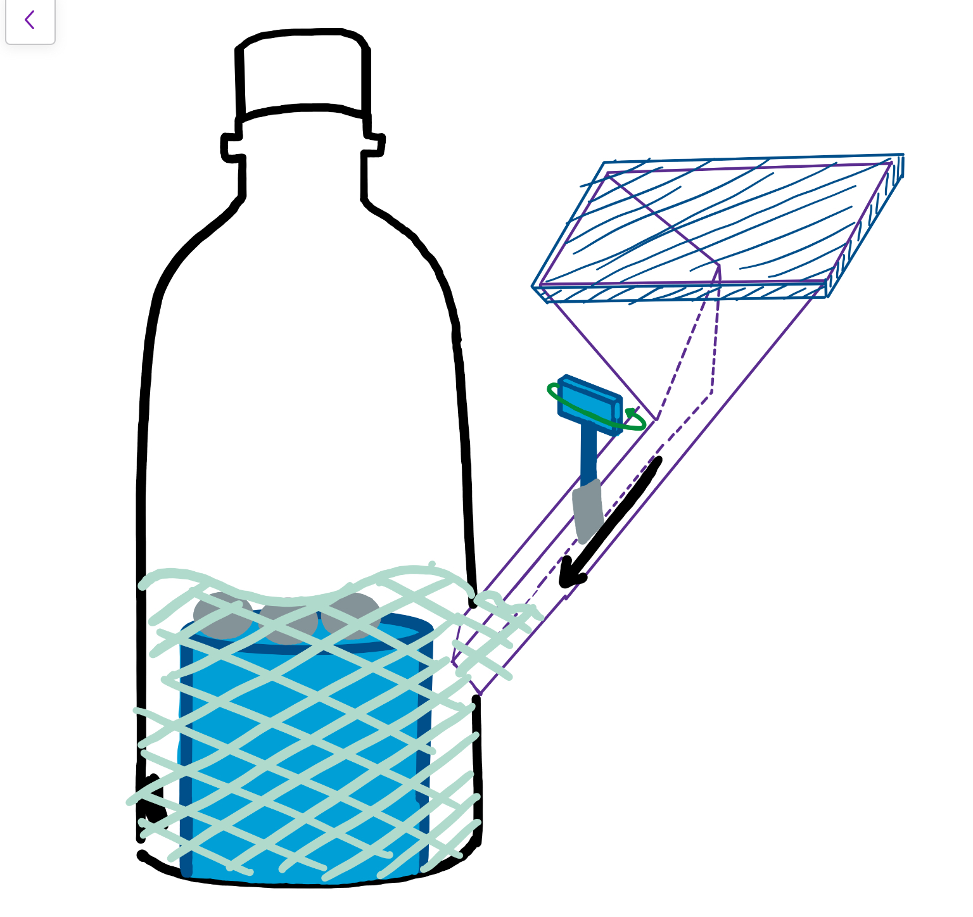
Device During Operation Configuration
Stage 1: Valve is twisted open and allows the soda water to pour through into the vessel. The soda water's height increases in the vessel up to where the mentos are positioned on the stand and the reaction commences.
Stage 2: Reaction continues while the valve is open, theoretically no pressure should escape due to the soda water blocking the entrance and lid covering the top of the funnel.
Status of Materials during Operation
Valve will be open
Expected to allow soda water through and into the vessel
Lid will be sealed on funnel
Expected to prevent pressure leakage from the system
Bottle will be sealed
Expected to prevent pressure leakage from the system

Slide 5
Device Post-Operation (Clean-up) Configuration
Stages of cleaning:
Stage 1: the bottle cap/pressure reader will be slowly opened, to allow pressure to escape.
Stage 2: Pressure reader/lid will be removed from device.
Stage 3: Lid Removed from funnel.
Stage 4: Funnel plus pressure chamber rinsed out with water, to remove excess reactants, and drained from the top.
Stage 5: Water is removed where possible, and system is set to dry.
Stage 6: System is reset and prepared for another run.

Slide 6
Plan / Schedule
First Step (Before Week 7 Studio): Discuss and acquire materials listed from various sources needed:
Funnel with attached tube and valve – Previously owned by team member within the group
Funnel Lid – Created by team out of small piece of plastic to cover the top of the funnel to prevent the release of extra pressure.
2L Soda bottle – Use clean and rinsed 2L soda bottle already previously purchased.
Mentos and Soda Water – Limited supply provided by studio instructor with extra resources already purchased from our local retail store.
Stand for Mentos – Created by team and inserted through the bottom of soda bottle to provide elevation for mentos during Week 7 Studio.
Second Step (During Week 7 Studio): Begin initial assembly stages of design by cutting into the soda bottle to insert stand with mentos into the bottle and attach acquired funnel and valve system to soda bottle.
Third Step (During Testing Phases in Studio Time): Test design parameters with both reactants mixed in our created project during class time to determine next steps required for future tests and design adjustments.
Fourth Step (Between Studio Dates): Adjust design structural flaws based on test results found in class before following studio session (e.g. removal of certain design structural aspects, amount of reactants needed for mixture)
Fifth Step (Following Studio Sessions: Week 8 and 9): Repeat steps four and five until successful with outcome of initial project category chosen.

Slide 7
Feasibility and Flaws
Feasibility:
Simplistic concept, with few difficult areas to construct.
Set up between runs is simple.
Design has limited, if not no very complex features, making for an easier assembly.
Flaws:
Dropping the Mentos down onto the stand from the top of the bottle could be unreliable, the Mentos could end up at the bottom of the bottle instead of on the stand.
Lid may not perfectly contain pressure.
May be unable to construct lid successfully (In which case we will alter design to use a plug instead).

